Slide 1
DISTRICT 1 Community SAFETY Meeting
Berkeley PD
September 28, 2023

Slide 2
Crime Trends
Recruitment and Retention
Technology Rollout
Community Resources
Agenda

Slide 3
Calls for Service & Crime Reports

Slide 4
Calls for Service 2019 – 2023
Calls for service volume has rebounded towards the historical average since 2021.
'20 averaged 3,821 calls per month
YTD averaging 4,177 (+9% from '20)
49% of calls are labeled as priority level 1 or 2

Slide 5
Calls for Service 2019 – 2023
Calls for service volume has rebounded towards the historical average since 2021.
'20 averaged 543 calls per month
YTD averaging 621 (+14% from '20)
50% of calls are labeled as priority level 1 or 2

Slide 6
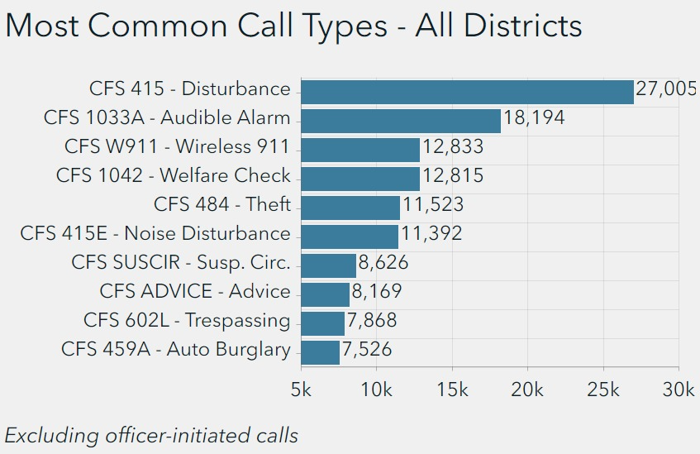
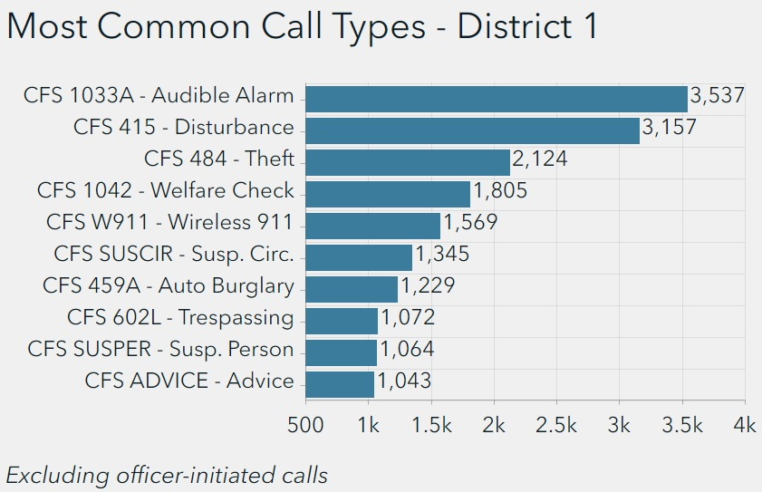
Calls for Service 2019 – 2023
The distribution of call types in District 1 reflects citywide trends.
Disturbances and Audible Alarms have been the most common call type
Calls regarding thefts are more prevalent in District 1

Slide 7
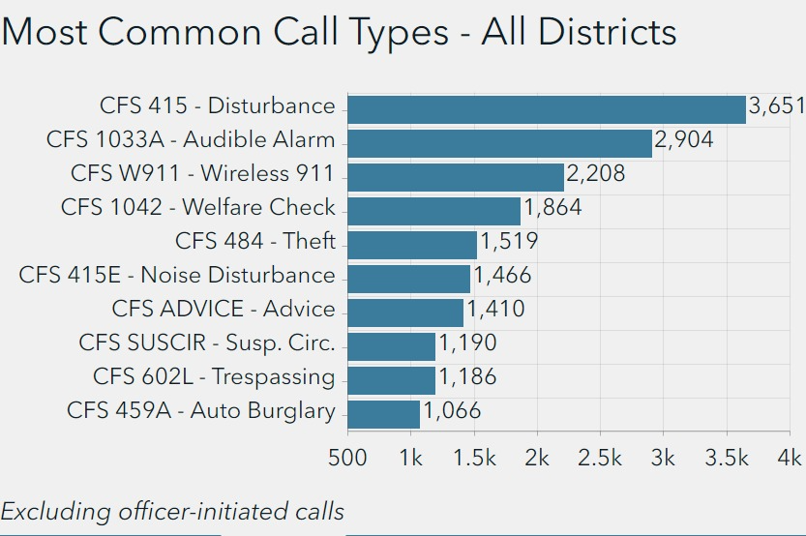
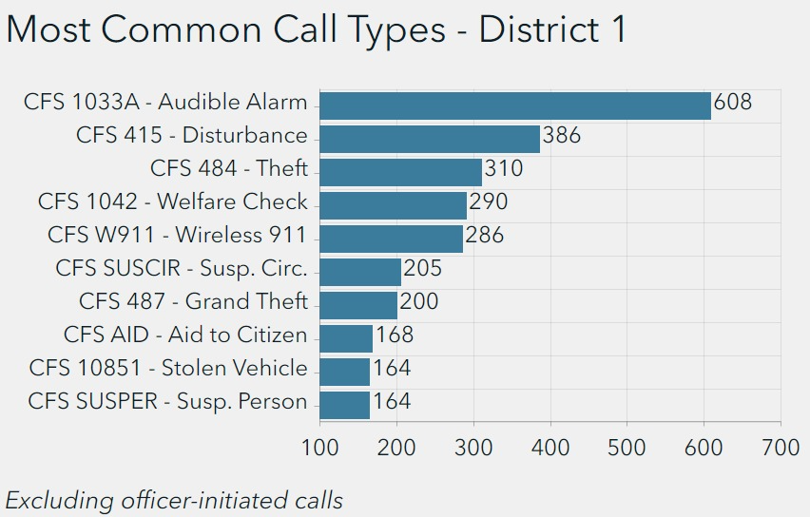
Calls for Service Jan. - AUg., 2023
Calls reporting auto burglaries are less common in District 1 in 2023.
Calls for auto burglaries increased citywide, while they decreased in District 1

Slide 8
Crime Reports 2019 – 2023
The number of crime reports across the city has rebounded past pre-2020 levels.
'19 averaged 892 crimes per month
YTD averaging 974 (+9% from '19)

Slide 9
Crime Reports 2019 – 2023
The increase in crime reports has been greater in District 1 than citywide.
'19 averaged 155 crimes per month
YTD averaging 175 (+13% from '19)

Slide 10
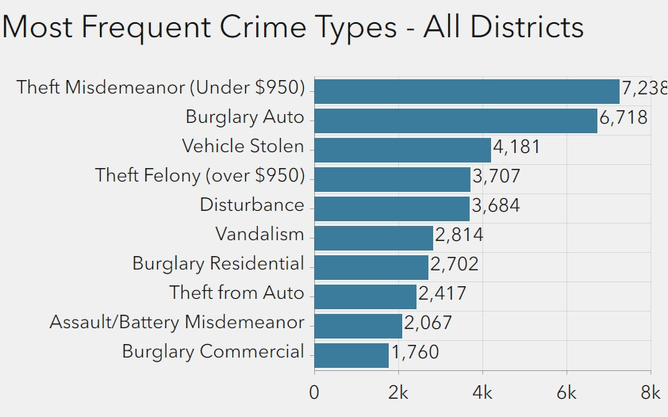
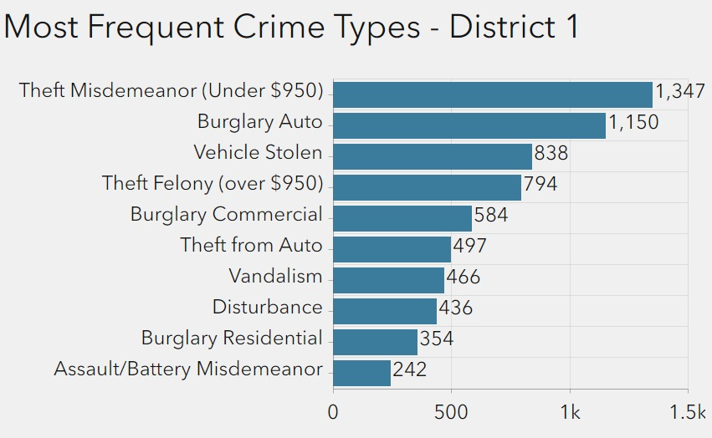
Crime Reports 2019 - 2023
Commercial burglaries have been more common in District 1 than citywide.
Otherwise, crime trends in District 1 mirror citywide trends

Slide 11
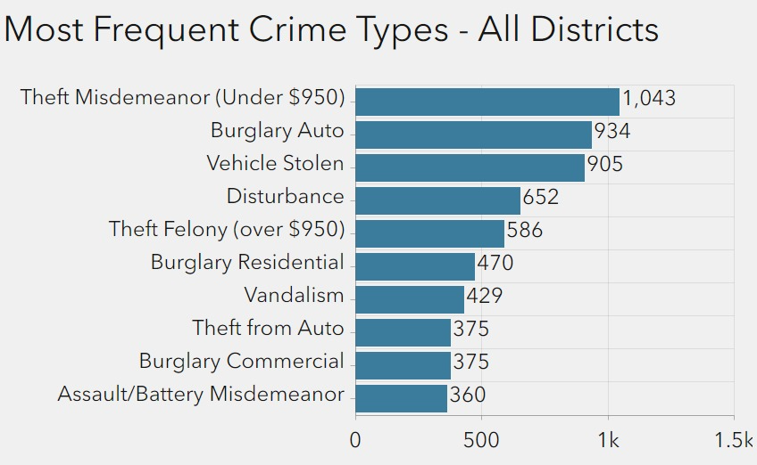
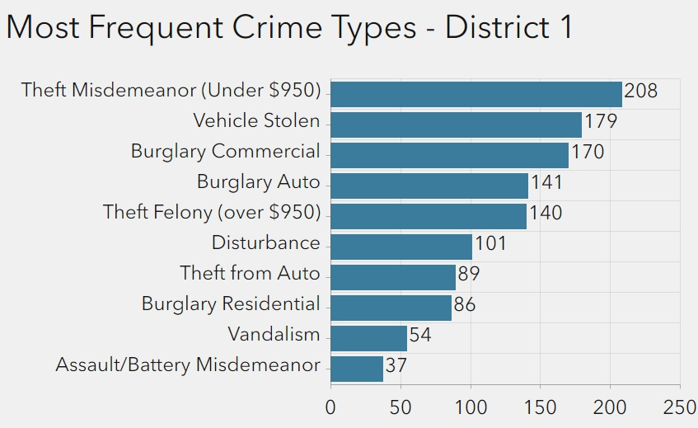
Crime Reports Jan. - Aug., 2023
Stolen vehicles have increased citywide and in District 1.
District 1 continues to see a relatively high proportion of commercial burglaries

Slide 12
Report crimes and suspicious activity
Track neighborhood trends
Crime prevention through environmental design
Follow crime-specific prevention guidelines
Camera registry
Community Resources

Slide 13
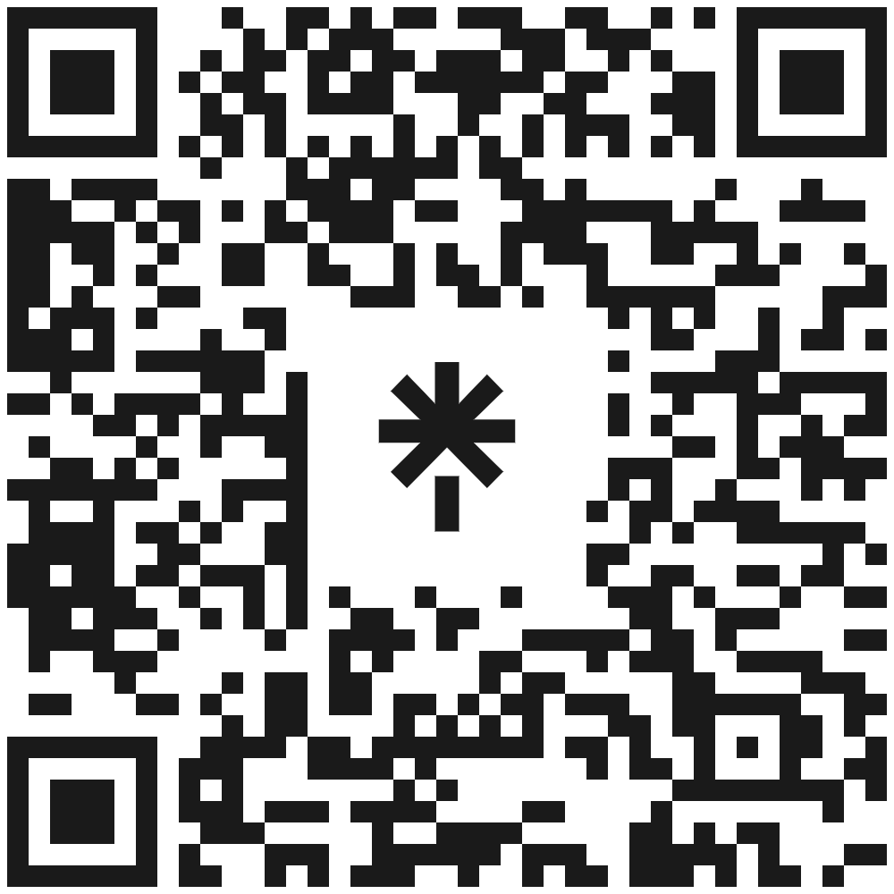
Lt. Matt McGee
Community Services Bureau (510) 981-5808 mmcgee@berkeleyca.gov OFc. GEORGE SCHIKORE
Area coordinator (510) 981-5774
GSCHIKORE@BERKELEYCA.GOv Arlo MALMBERG Strategic Analysis Team (510) 981-5799 amalmberg@berkeleyca.gov

Slide 14
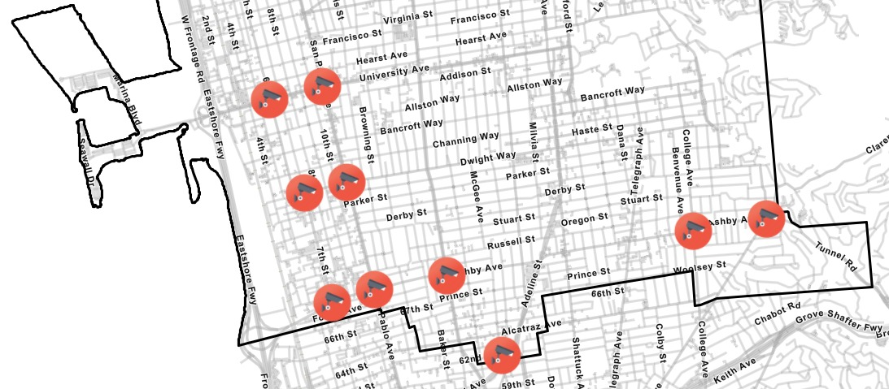
Security Cameras
Total of 8 cameras
Installation is underway
Project managed through Public Works
Strong privacy protocols in place

Slide 15
Policy Approved
Authorization from council to execute a contract
Secure contract
Notify council of locations
Installation
Training
License Plate Readers

Slide 16
4 police recruits will graduate in December
1 police recruit who will attend the academy in October (expected April graduation)
3 new dispatchers on October 1st
Parking Enforcement Officer testing in December
Currently 138 Community Service Officer applicants
Staffing
Current Staffing | Police | Dispatch | CSO | PEO
 | 144 of 181 authorized | 25 of 36 (incl. 7 in training) | 25 of 29 | 21 of 24

Slide 17
Recruitment and Retention Incentive Program
Recruiting events
Epic - recruitment content
Growing recruitment team
Recruitment & Retention

